Slide 1
EQUIPMENT MANAGEMENT
Presentor: Nguyen Lam Hoang Anh

Slide 2
Contents
REQUIREMENTS
SYSTEM SPECIFICATION
DEMO
OVERVIEW

Slide 3
REQUIREMENTS
Equipment may have type (PC/Laptop), name, ID, status and description.
Equipment may be assigned to one or no employee.
System can add, edit, remove and view equipment and list user's assinged equipment.
Implement error handling and data validation

Slide 4
SYSTEM SPECIFICATION
1
2
3
4
5
Technologies
System architecture
Database design
Features
Laravel concepts

Slide 5





Technologies
Front-end
Back-end

Slide 6
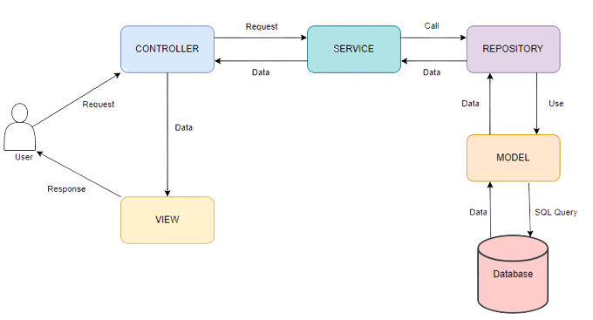
System architecture

Slide 7
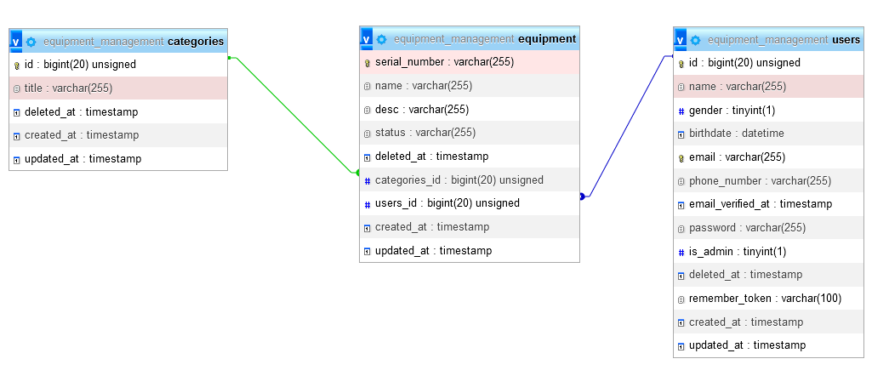
Database design

Slide 8
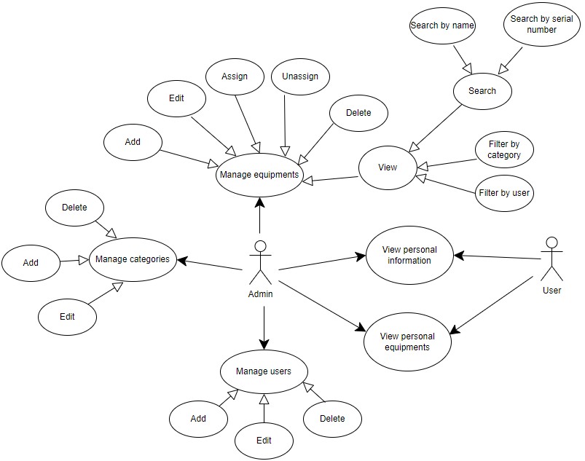
Features

Slide 9
Laravel concepts
Routing
Controller
Eloquent ORM
Database: Migration, Seeder, Factory
Middleware
JWT (Json web token)
Resource collection

Slide 10
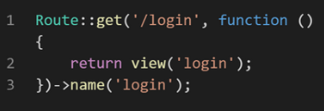

Routing
Web route
API route

Slide 11
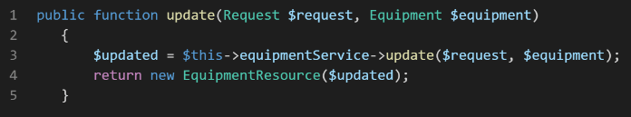
Controller
EquipmentController

Slide 12
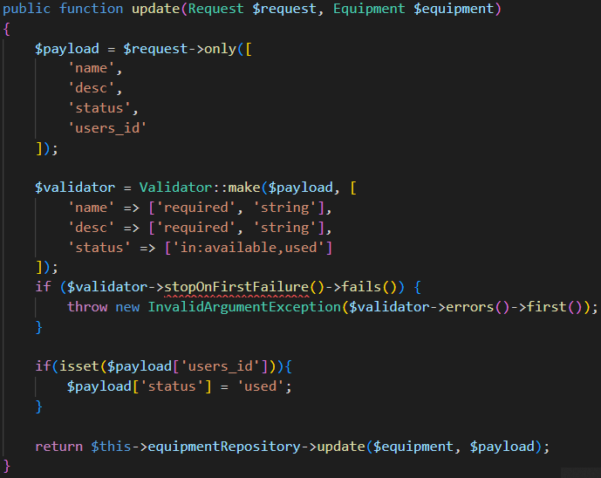
Service
EquipmentService

Slide 13
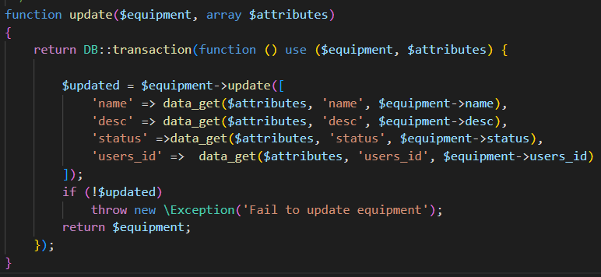
Repository
Update method of EquipmentRepository class

Slide 14
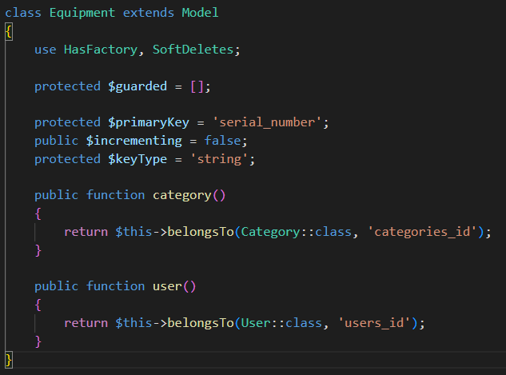
Eloquent ORM
Equipment Model

Slide 15
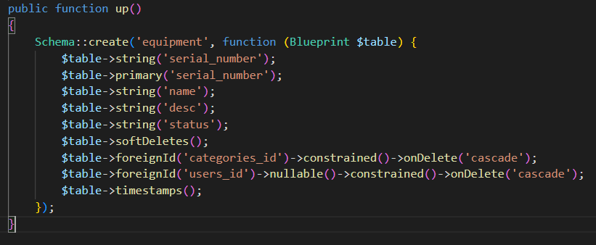
Migration
up function in Equipmetn Migration

Slide 16
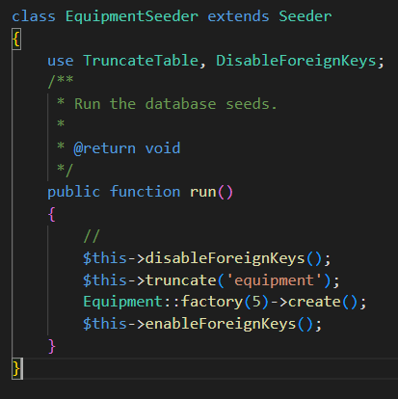
Seeder
Equipment Seeder class

Slide 17
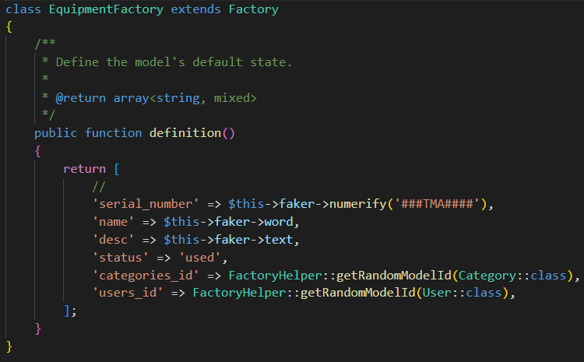
Factory
Equipment Factory class

Slide 18
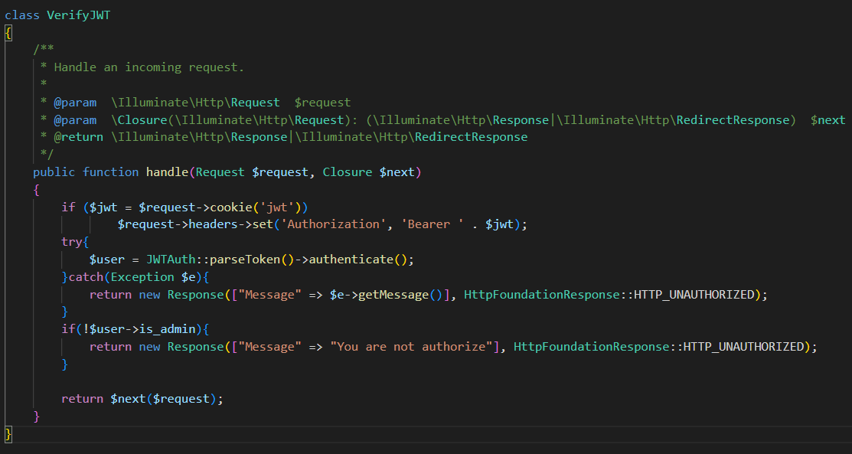
Middleware
VerifyJWT middleware class

Slide 19
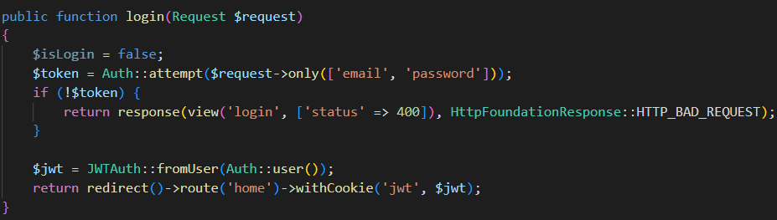
JWT
Generate JWT Token when login success

Slide 20
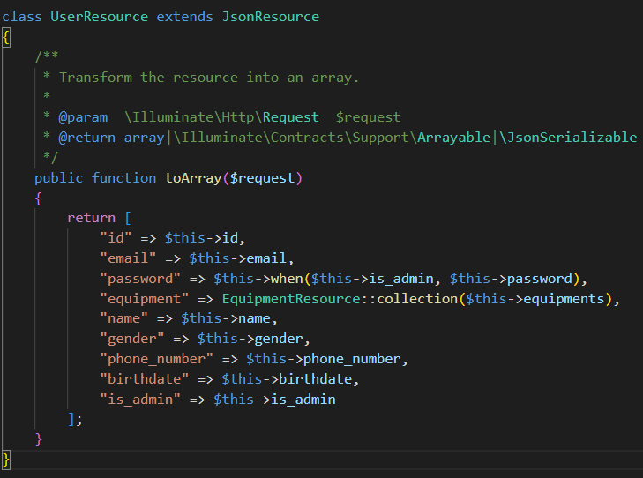
Resource collection
UserResource class

Slide 21
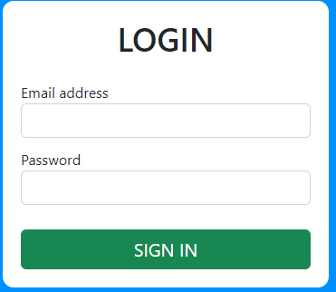
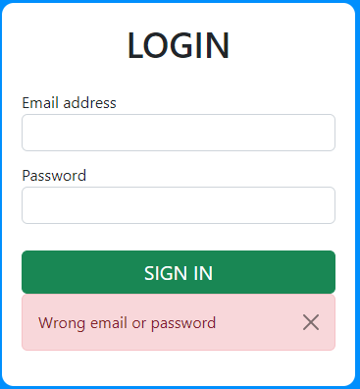
DEMO
Login page and error message

Slide 22
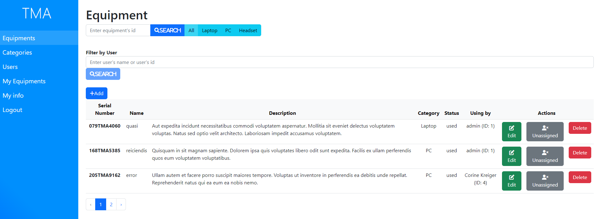
DEMO
Equipment page

Slide 23
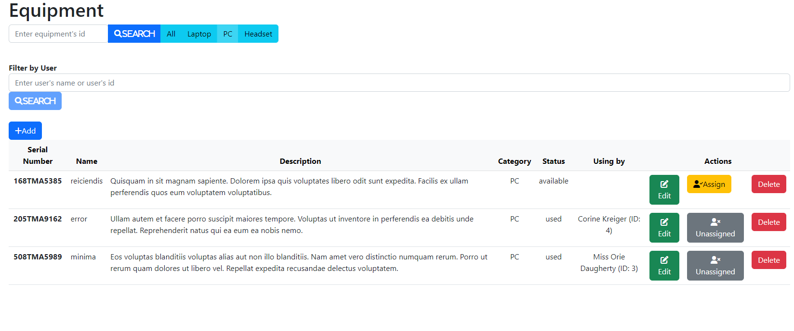
DEMO
Equipment page (Filter by PC)

Slide 24
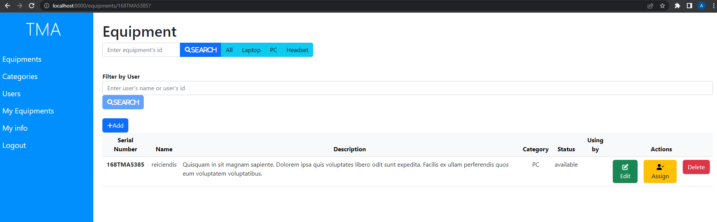
DEMO
Equipment page (Search by SerialNumber)

Slide 25
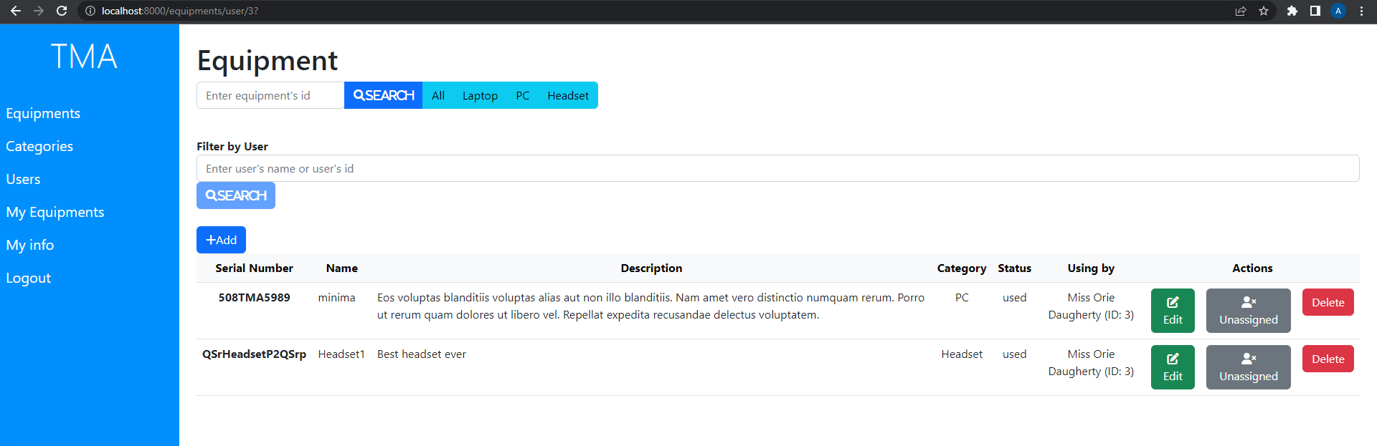
DEMO
Equipment page (Filter by user's name or user's id)

Slide 26
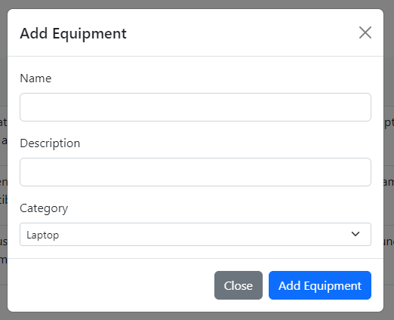
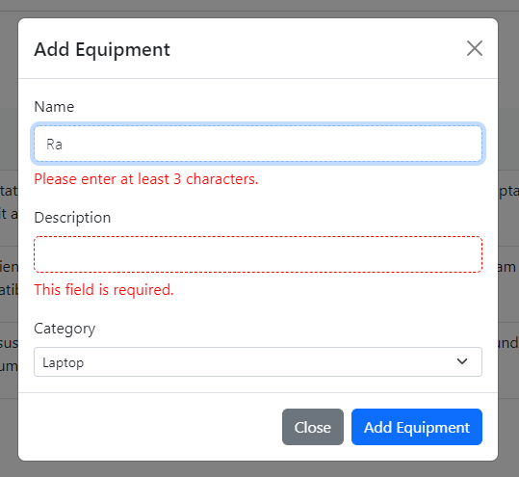
DEMO
Add equipment modal with error messages
Add equipment modal

Slide 27
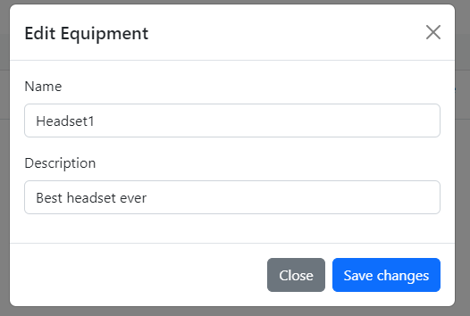
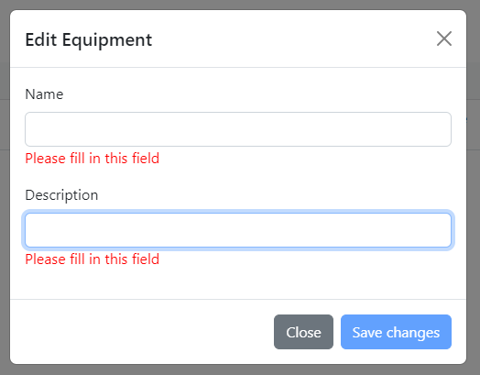
DEMO
Edit equipment modal with error messages
Edit equipment modal

Slide 28
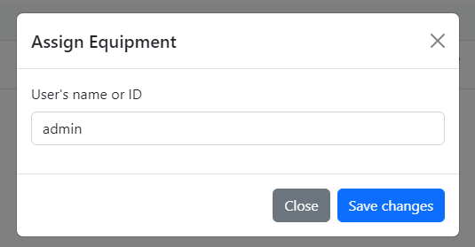
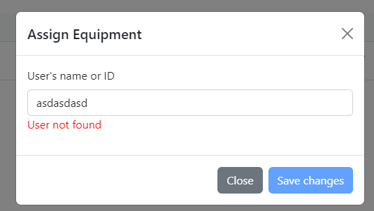
DEMO
assign equipment modal
assign equipment modal with error

Slide 29
OVERVIEW
1
2
3
Advantages
Disavantages
Future improvements

Slide 30
Advantages
Searching equipment with both serial number or name.
Manage equipments easily with simple user interface.
Validate data from both front-end and back-end

Slide 31
Disadvantages
User may accidentally press unassigned button.
Normal user can not request for equipments.
User can not update their information.

Slide 32
Future improvements
Implement missing features in disadvantages section.
Add new features for upload equipments images.
Add new features to sort equipments by each attributes.

Slide 33


Slide 34


